Slide 1
Nature Stewardship Art
hhmi|Tangled Bank Studios

Slide 2
Spot the Difference
Nature Bingo
Senses
Nature Journal
Postcard
Slide 3
Slide6
Slide 7
Slide 9
Slide 10

Slide 3
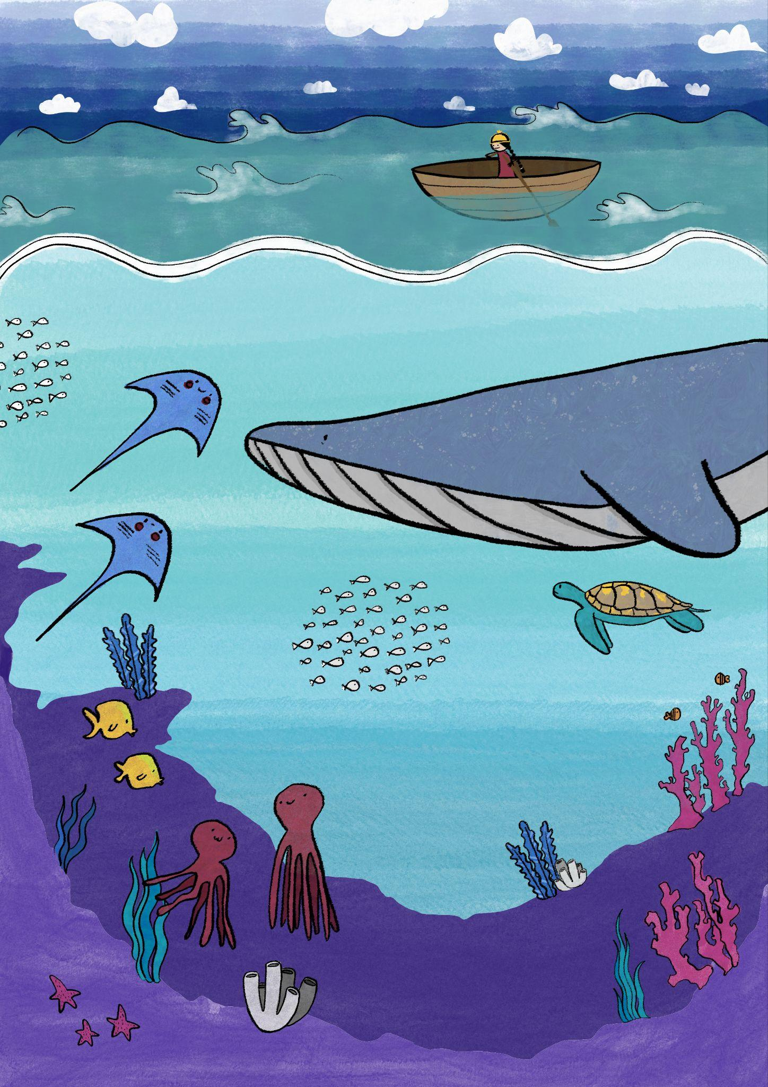
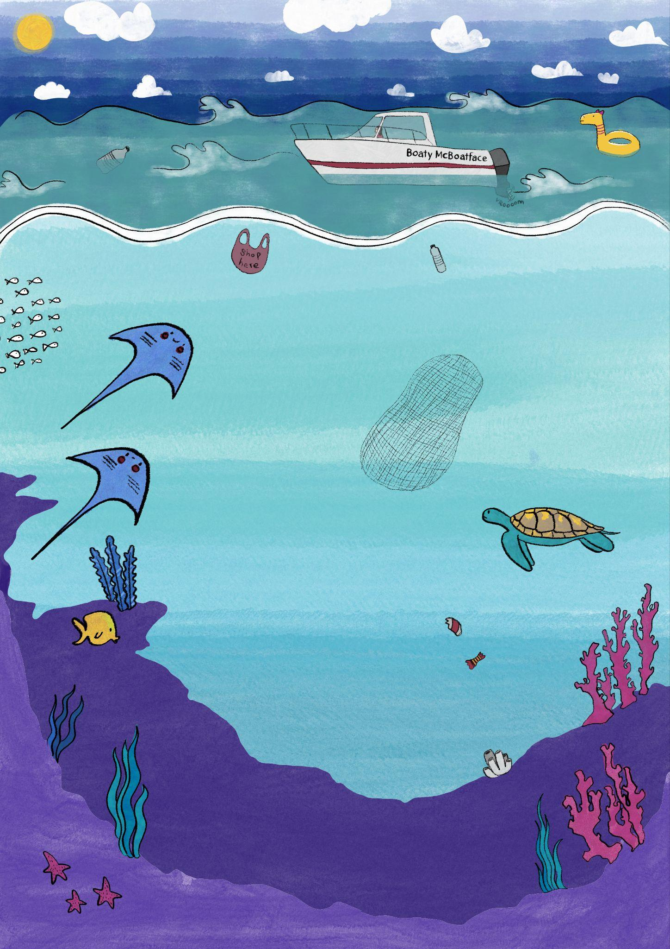

Slide 4
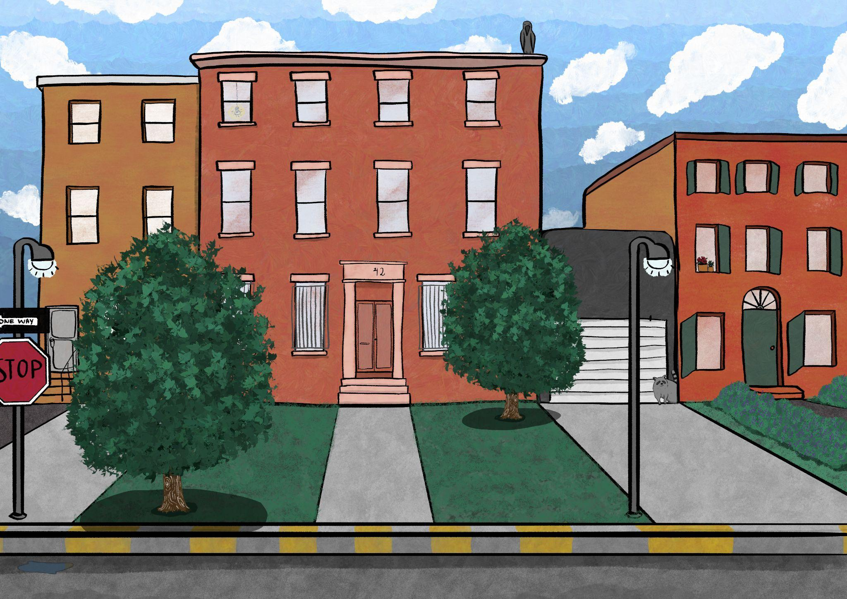

Slide 5
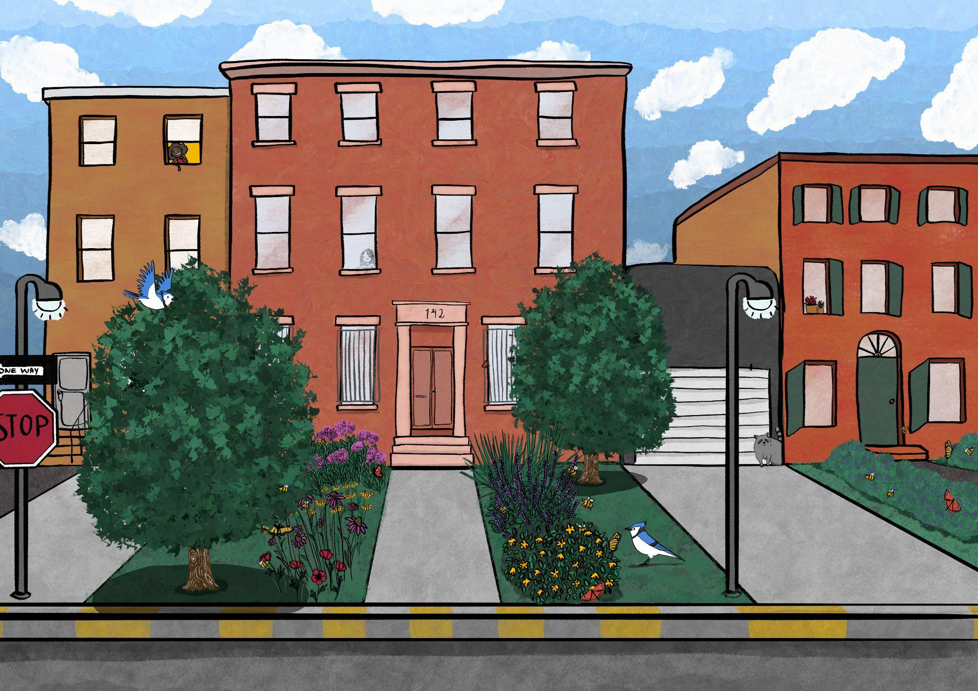

Slide 6
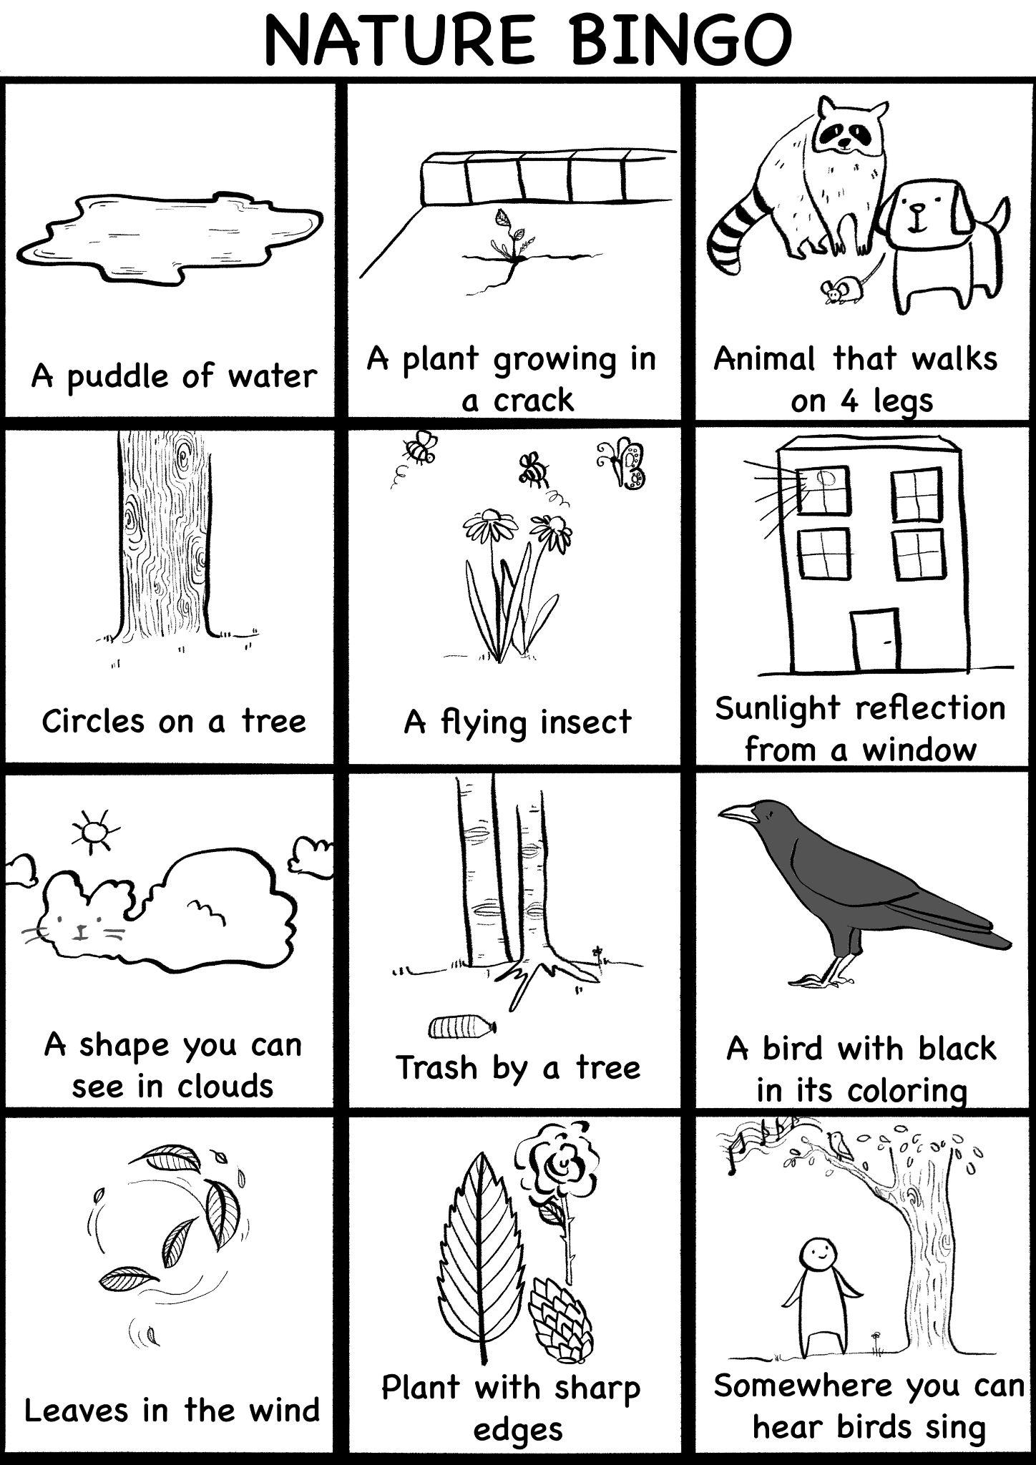

Slide 7
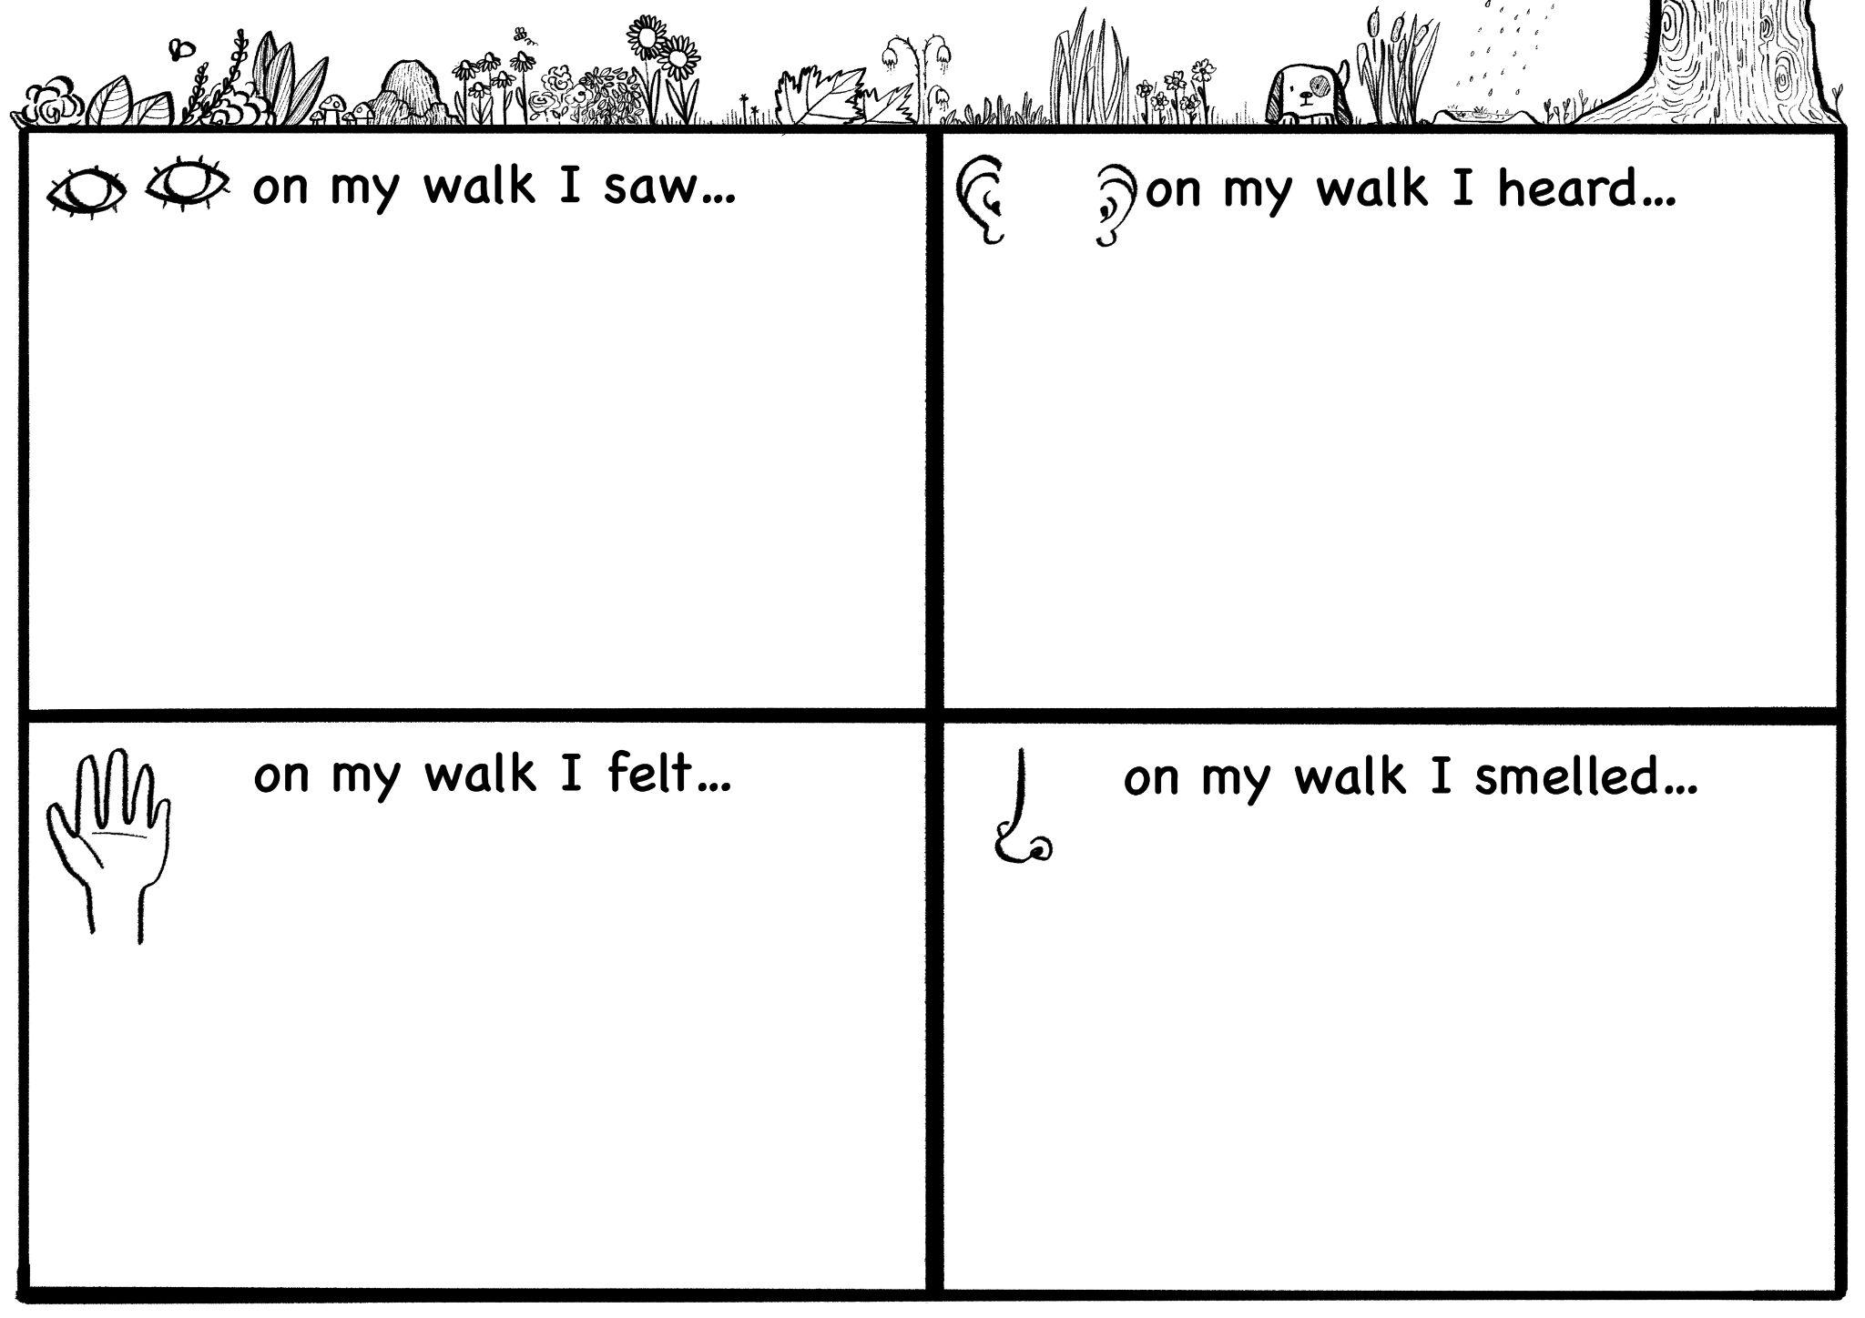

Slide 8
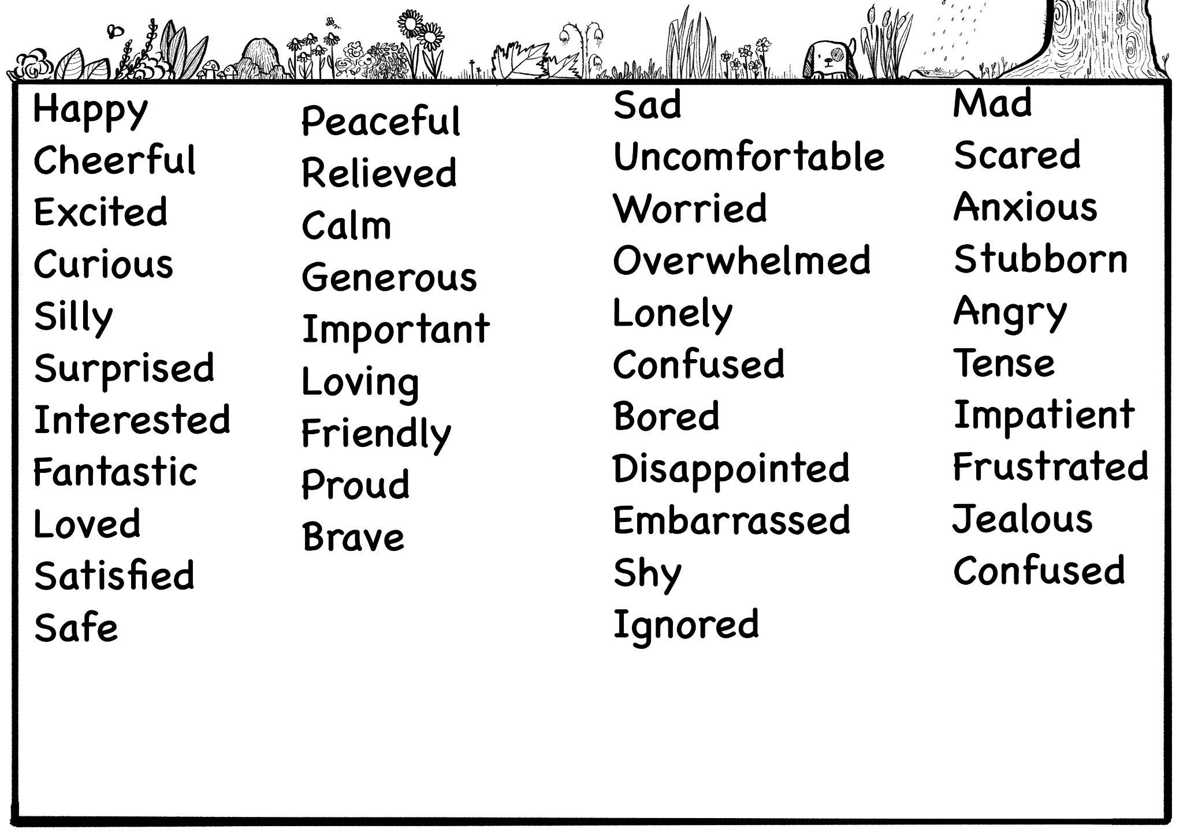

Slide 9
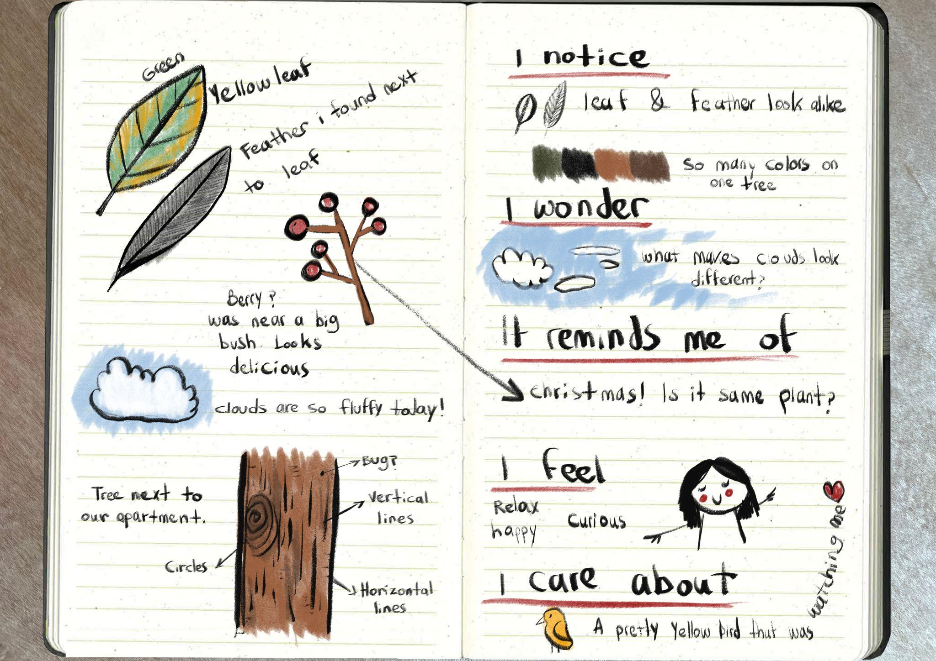

Slide 10
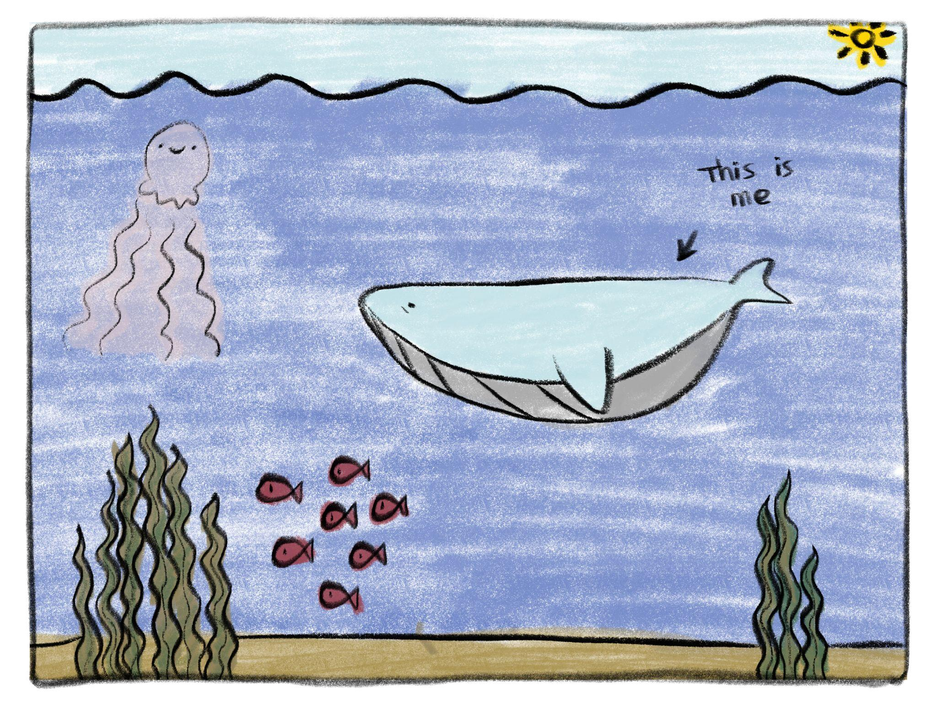

Slide 11
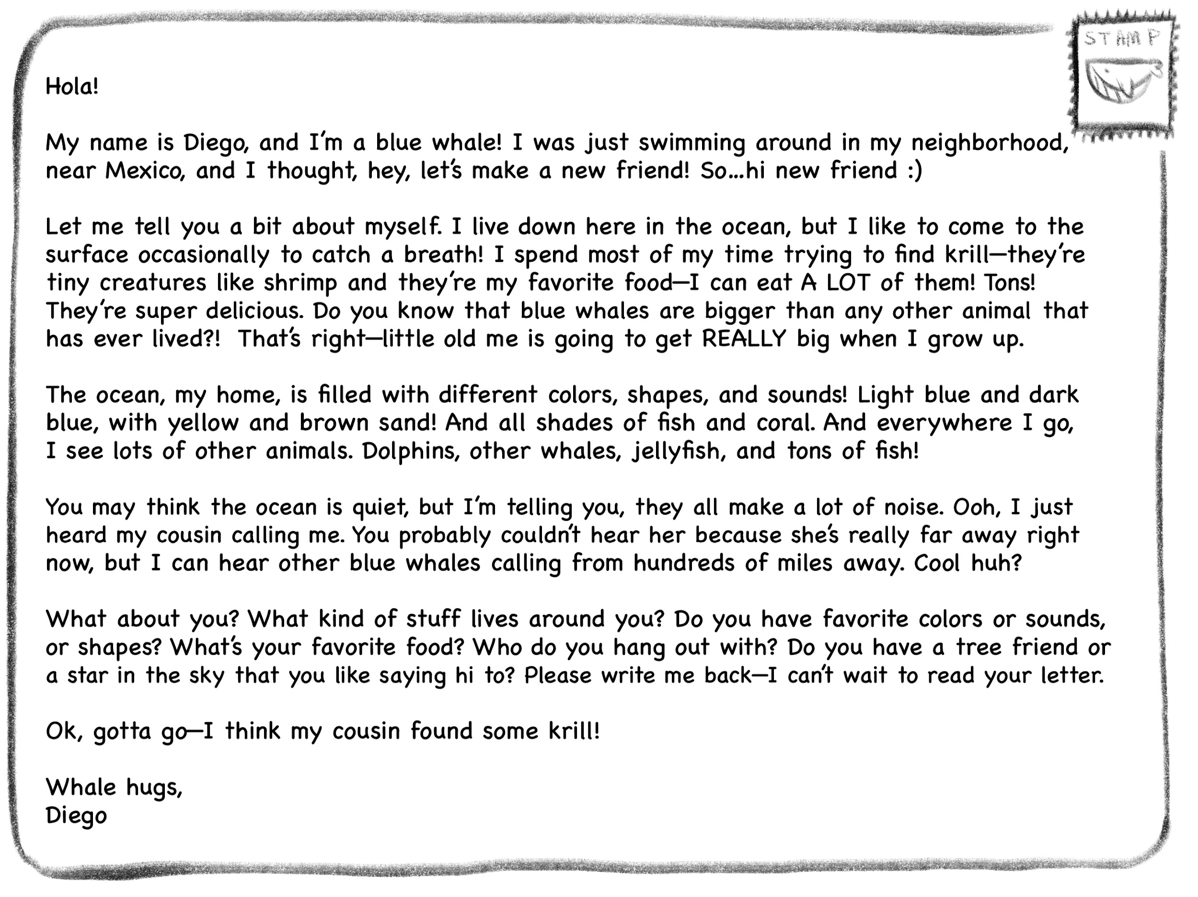
Letter Comes Here.

